Slide 1
Personality
Chapter 12

Slide 2
Personality
What is personality?
emotion
thinking
time
behavior
relationships

Slide 3
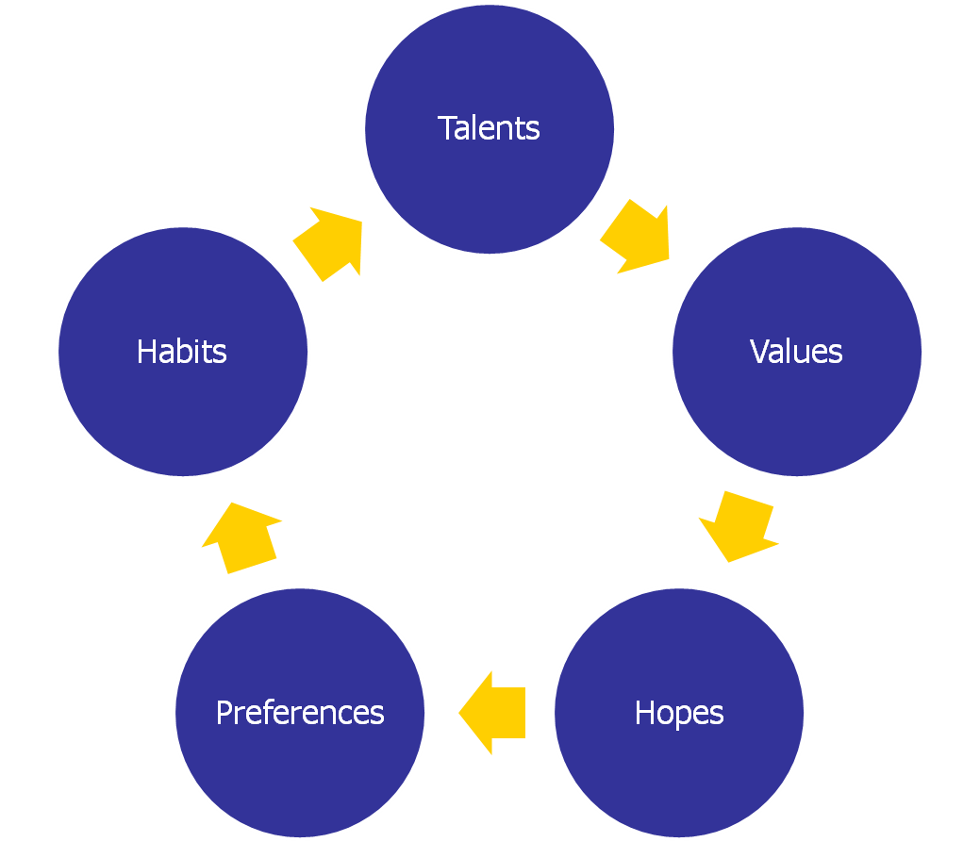

Personality

Slide 4
Personality
Personality theories
  Trait versus state
    Stable, enduring patterns
    Eysenck’s theory (Figure 12.2 page 406)
      Check the traits you feel are descriptive of your personality
    Adjective checklist (Table 12.1 page 407)
      Check the traits you feel are descriptive of your personality
  Psychoanalytic
    Internal conflicts and struggles
  Humanistic
    Private, subjective experiences and personal growth
  Behavioral and social learning
    External environment and conditioning and learning

Slide 5
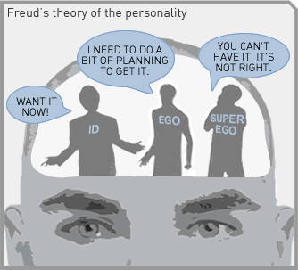
Personality
Psychoanalytic theory

Slide 6
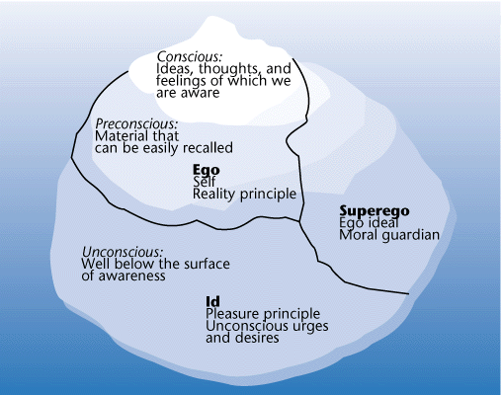
Personality
Psychoanalytic theory

Slide 7
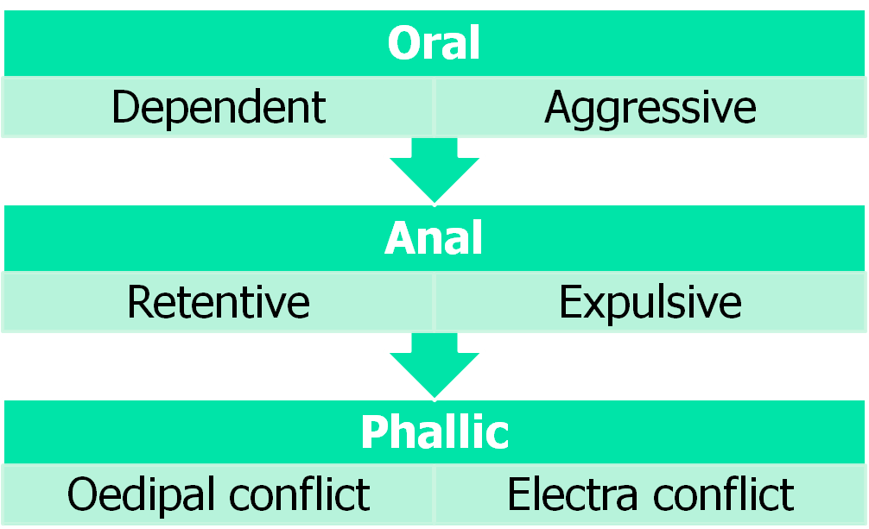
Personality
Psychoanalytic theory
  Psychosexual stages of development

Slide 8
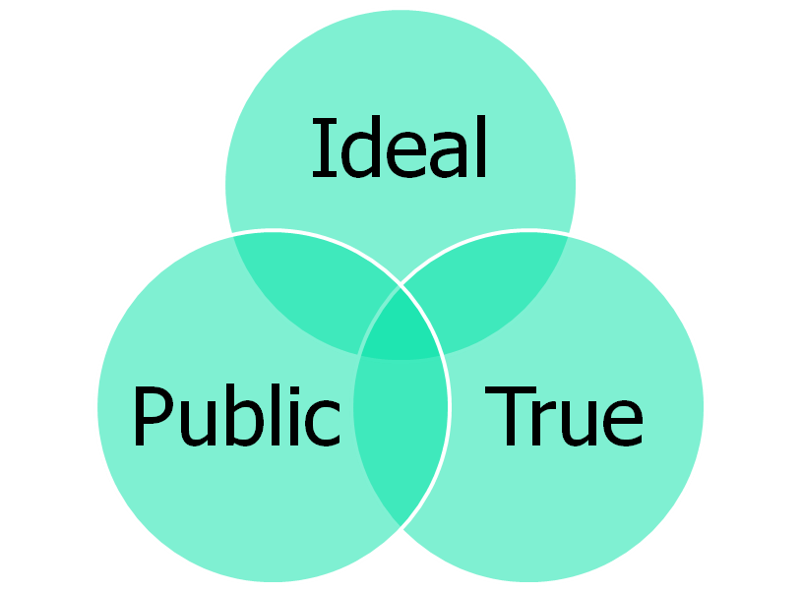
Personality
Humanistic theory
  Self-image
    Flexible and changing perception of personal identity, body, personality
    Conditions of worth
    Positive self regard
    Unconditional positive regard

Slide 9
Personality
Humanistic theory
  Well-being
    Wisdom and knowledge
      Creativity, curiosity, open-mindedness, love of learning, perspective
    Courage
      Bravery, persistence, integrity, vitality
    Humanity
      Love, kindness, social intelligence
    Justice
      Citizenship, fairness, leadership
    Temperance
      Forgiveness, humility, prudence, self-control
    Transcendence
      Appreciation of beauty and excellence, hope, gratitude, humor, spirituality

Slide 10
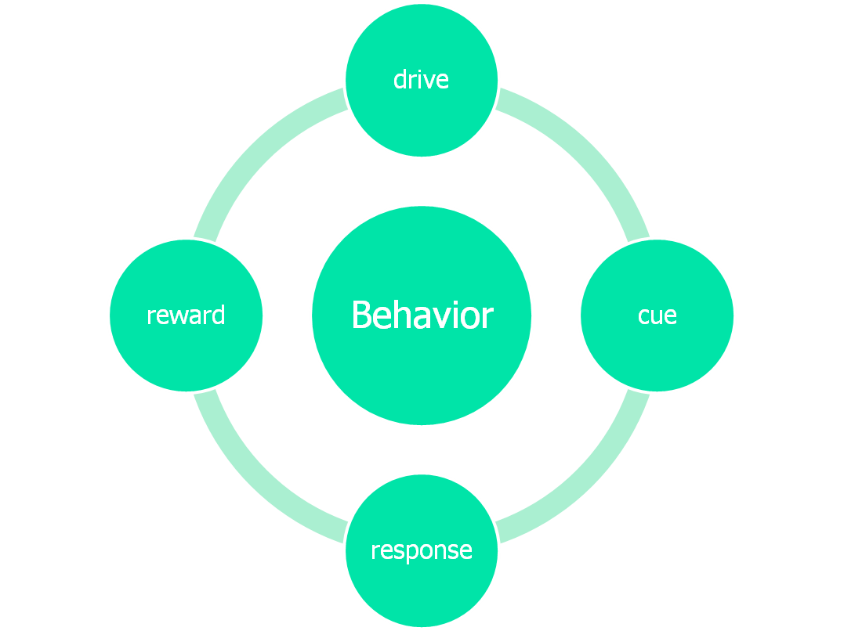
Personality
Behavioral and social learning theory
  4 elements of learning

Slide 11
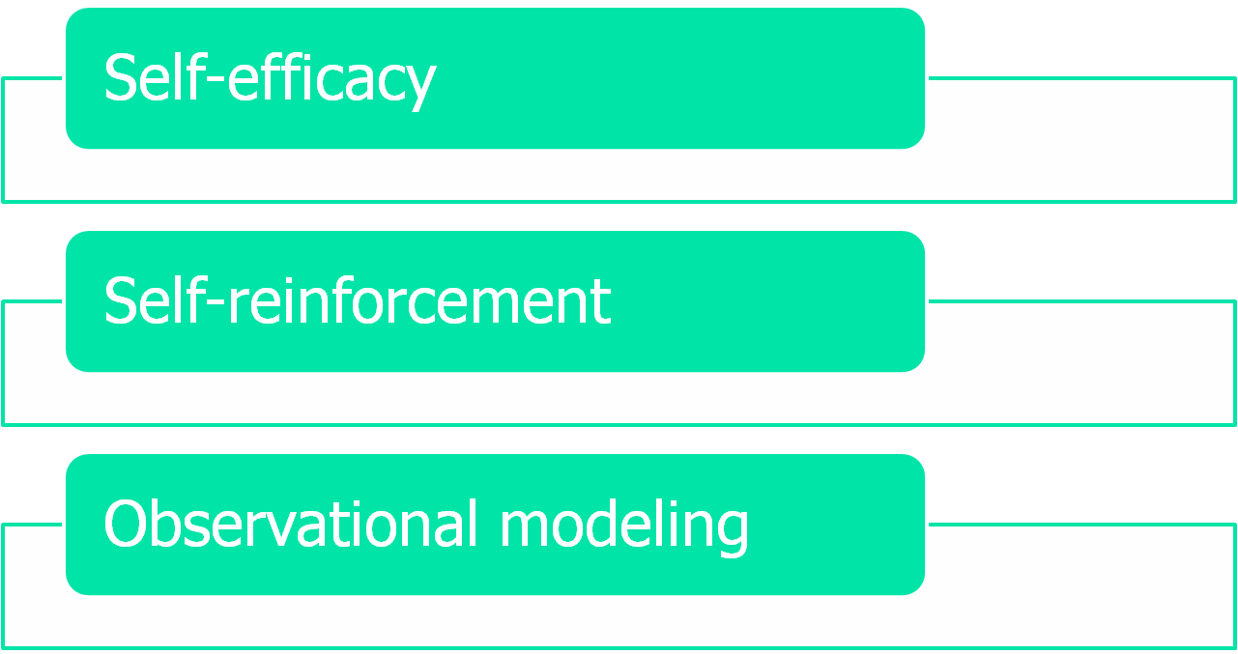
Personality
Behavioral and social learning theory

Slide 12
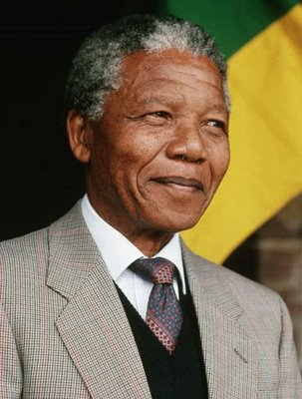
Personality
Personality Profile
  Nelson Mandela http://video.google.com/videoplay?docid=5502552241483562632&ei=0TXiSoWcG5WUqAPP-f3CDA&q=major+theories+of+personality&hl=en#
    Psychoanalytic Theory (pages 411-416)
    Humanistic Theory (pages 417-421)
    Social Cognitive Theory (pages 421-425)

Slide 13
Personality
The Big Five
  O.C.E.A.N.
    Openness
      Intelligence and seeking experiences
    Conscientiousness
      Self discipline, responsibility, achievement
    Extroversion
      Outgoing, risk taking
    Agreeableness
      Friendly, nurturing, caring
    Neuroticism
      Negative, upsetting emotions; anxiety; irritable

